Slide 1
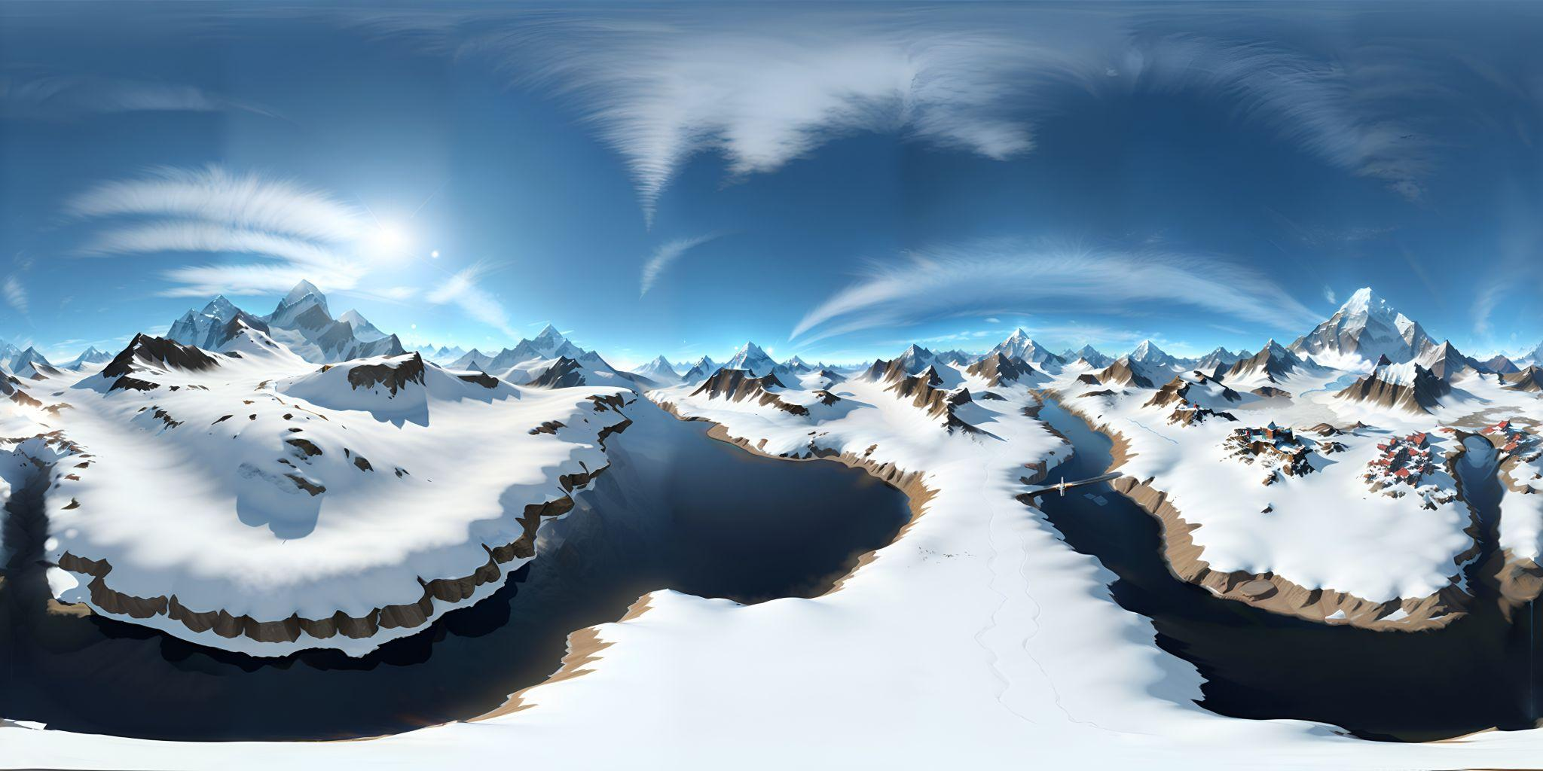
Climbing Everest:VR Experience
Presentation by-Muskan K C
ARTI 602-M01

Slide 2
Introduction
-VR technology has emerged as a powerful tool for simulating real- life environments and experiences
The use of VR in outdoor recreation, particularly mountaineering , has gained significant attention
-Mount Everest , standing at 8848 meters , is the tallest peak in the world and dream for many adventure enthusiast

Slide 3
Problem Statement
-Climbing Everest or any mountain poses physical and mental challenges and requirement
-Due to inaccessible to most due to physical and geographical limitation, only few have had the experience of climbing Mount Everest
-The project aims to provide a safe, accessible, and immersive way for people to experience the thrill and challenge of climbing Mount everest
-It aims to serve as a platform for research on the effects of altitude and extreme weather conditions on the human body
It aims to provide an alternative to the physical risks and challenges associated with climbing Mount Everest

Slide 4
Benefits of VR in mountaineering
-VR allows climbers to experience the thrill of mountaineering without putting lives at risk and also saving the cost to climb the actual mountain which ranges from $30,000-$60,000
-VR can be used as a training tool to enhance skills , develop strategies and study the effects of altitude and extreme weather conditions on human body
It can be also used for educational purposes , allowing users to learn about the geography , history and culture of the region
Studies have shown that VR training can improve a climber’s performances, reduce the risk of injury

Slide 5
Possible Solutions
-It can provide a realistic experience of climbing a mountain, allowing users to experience the feeling of height and exposure without putting their lives at risk
-It can simulate different climbing scenarios, enabling climbers to train and develop strategies to overcome challenges
-It is a cost-effective alternative to traditional mountaineering, allowing more people to experience the thrill of climbing Mount Everest

Slide 6
Goal of VR App
Developing basic climbing skills - it can be sued as training tool for mountaineers to develop and enhance their climbing skills
Experiencing the thrill of climbing - for individuals who are unable to climb mountains due to physical or geographical limitation

Slide 7
Interaction Design
What interactions have you used in your game/simulation(teleportation, continuous movement, sockets, etc) and why? - Teleportation is ue

Slide 8
1 or 2 minute video of game/simulation

Slide 9
Conclusion
VR App on climbing Mount Everest can provide an immersive and educational experience for user
Users can experience the climb without the physical risks and challenges associated with the real climb

Slide 10
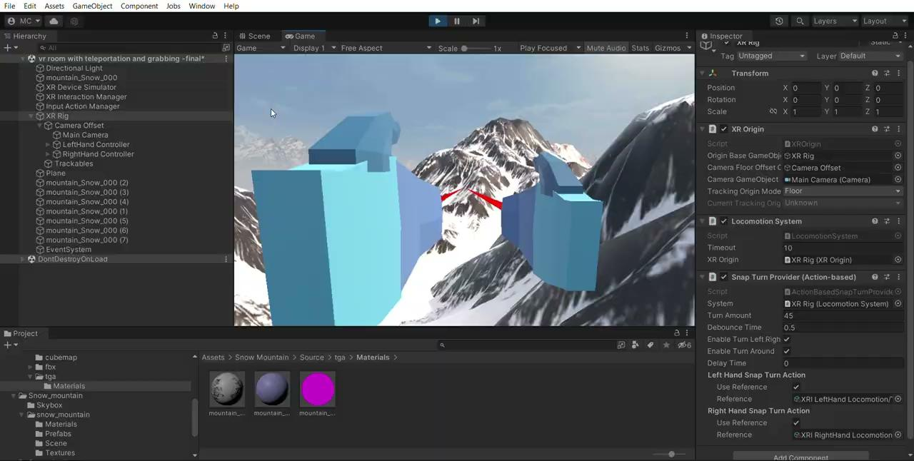
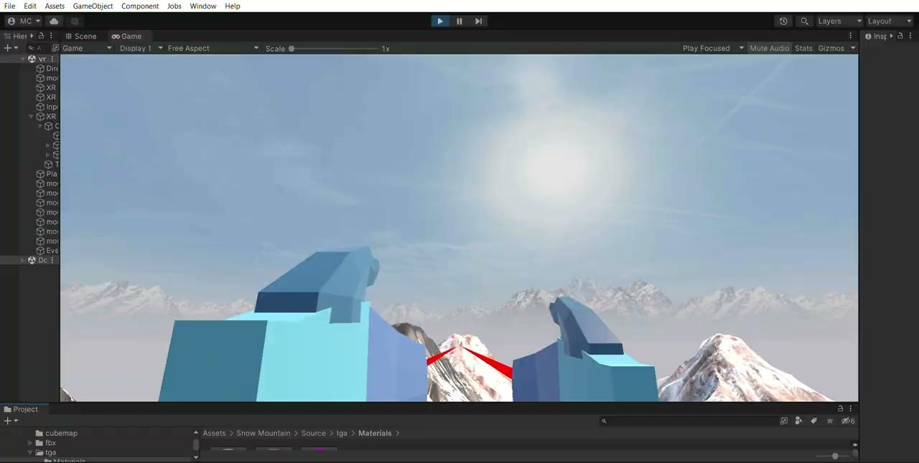
video

Slide 11
Existing VR applications for Climbing Mount Everest
-Several VR applications have been developed to simulate the experience of climbing Mount Everest
- Everest VR and The Climb are two popular VR application for Climbing Mount Everest

Slide 12
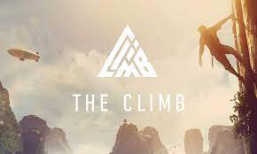
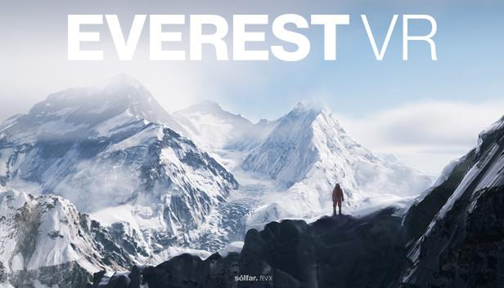

Slide 13
Creation of VR app for Climbing Mount Everest
Step 2: Develop a 3d model of Mount Everest using high resolution images and accurate topographical data

Slide 14
Creation of VR app for Climbing Mount Everest
Step 3: Create a VR app that simulates the experience of climbing Mount Everest with different routes and varying weather conditions

Slide 15
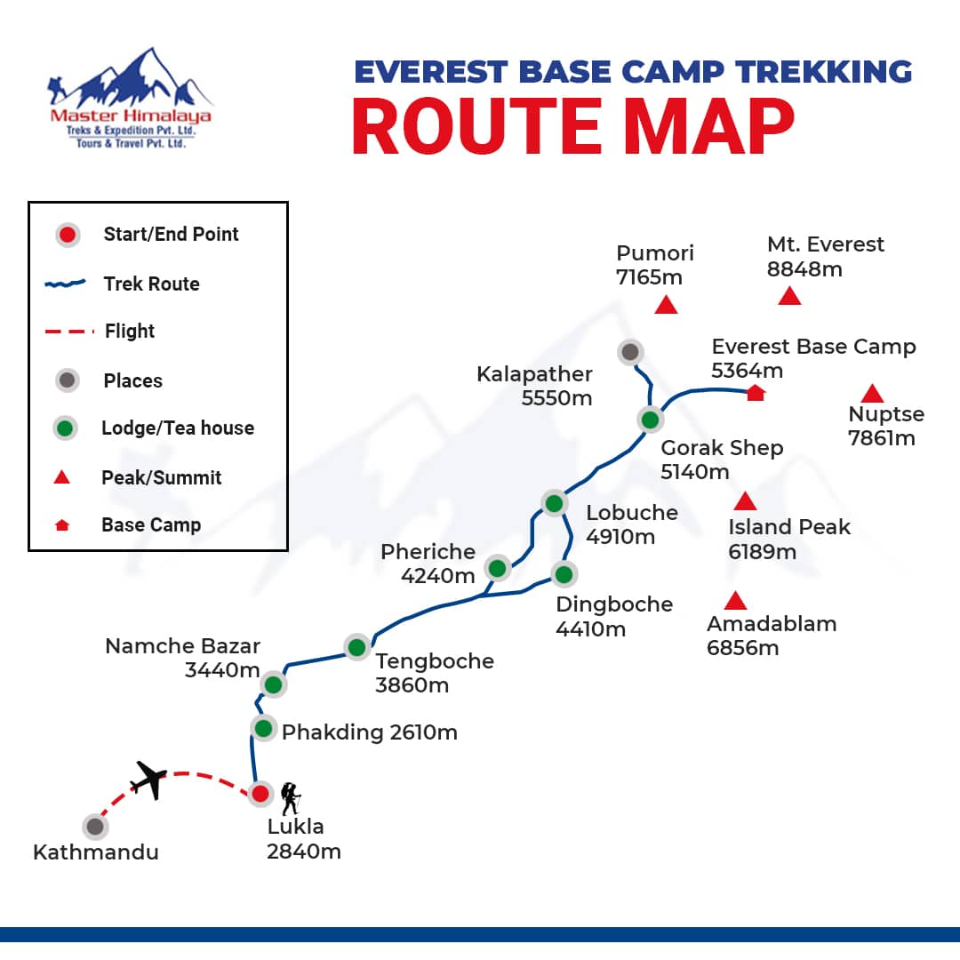

Slide 16
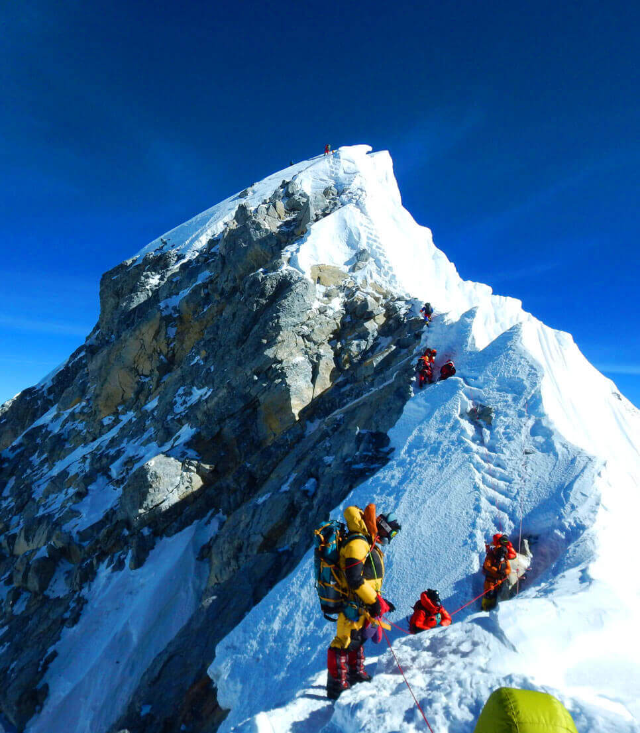
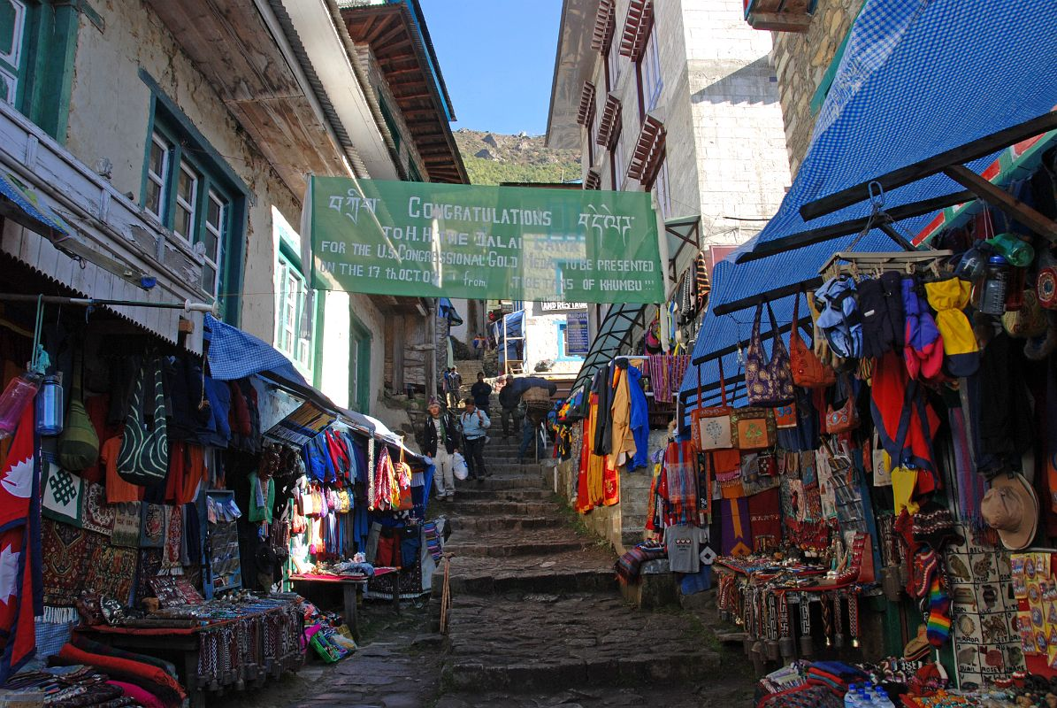

Slide 17
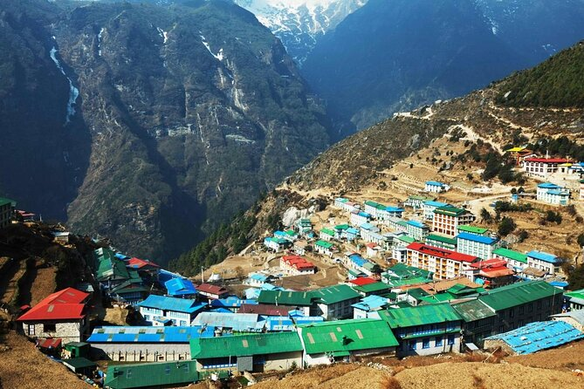

Slide 18
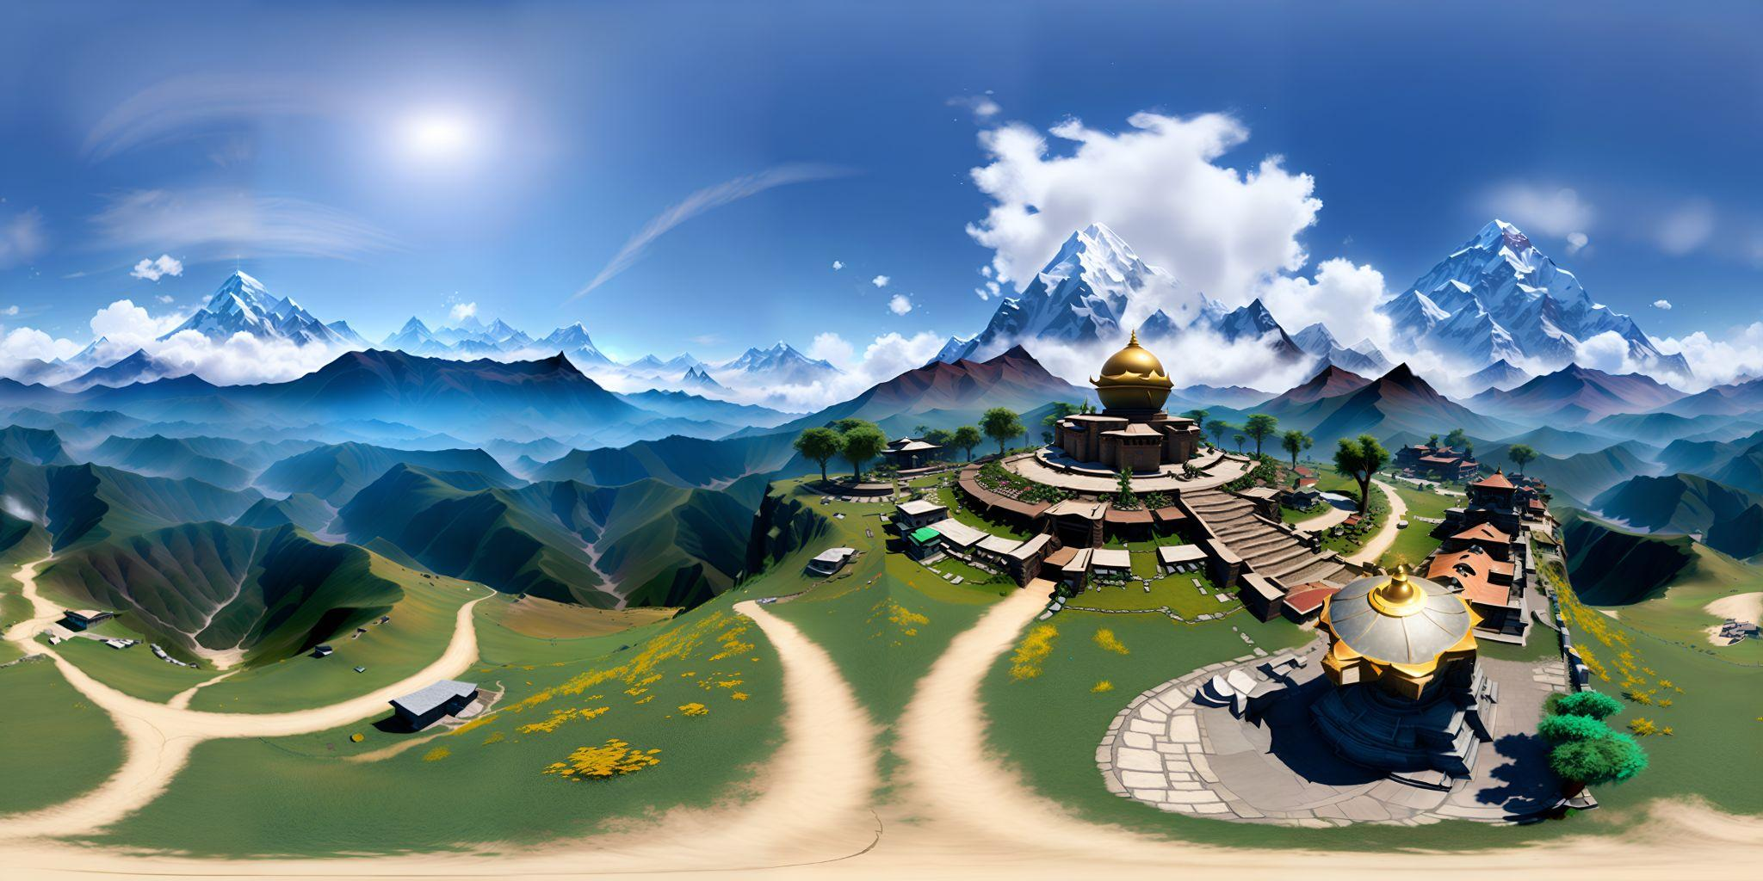

Slide 19
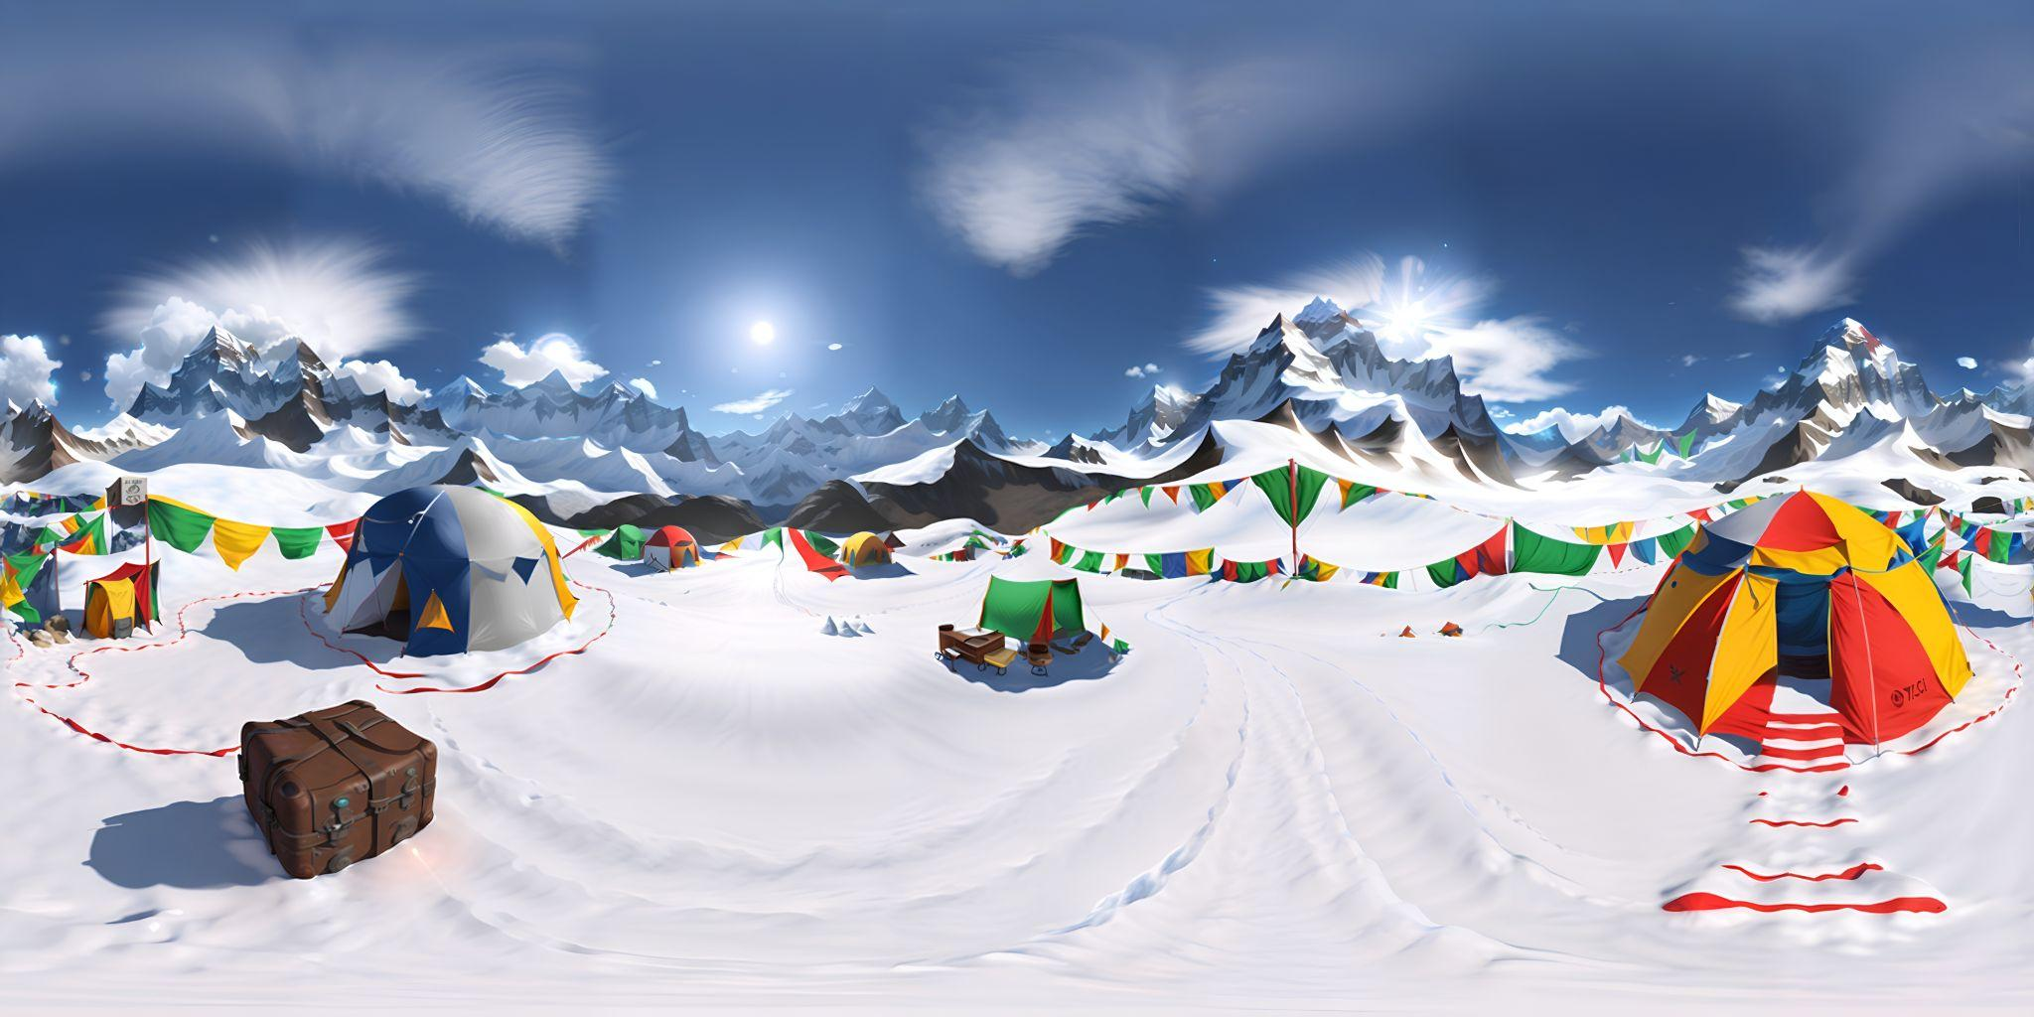

Slide 20
